Slide 1
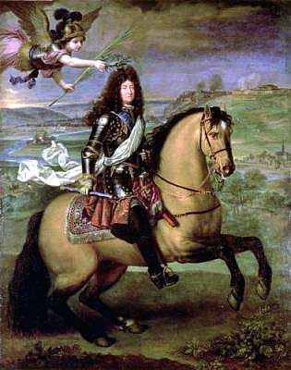
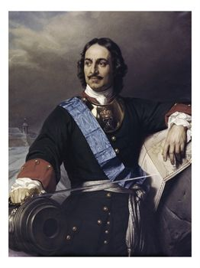
Section 1
THE AGE OF ABSOLUTISM

Slide 2
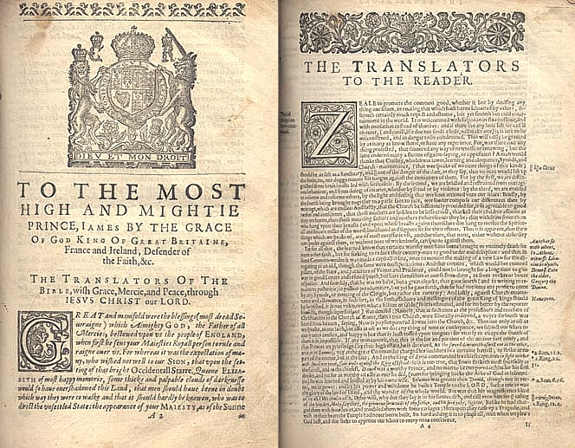
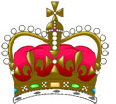
Absolutism
Monarchs had absolute power or sovereignty over their subjects
Sovereignty
Supreme power of national monarchs
Divine Right of Kings
Monarchs claimed that their power came directly from God

Slide 3
Men live like animals in a ruthless “state of nature” with no laws, “war of every man against every man, solitary, poor, brutish, nasty, and short.”
Thomas Hobbes
said that people had to obey the ruler no matter what, or else their natural selfishness would result in disaster for everyone

Slide 4
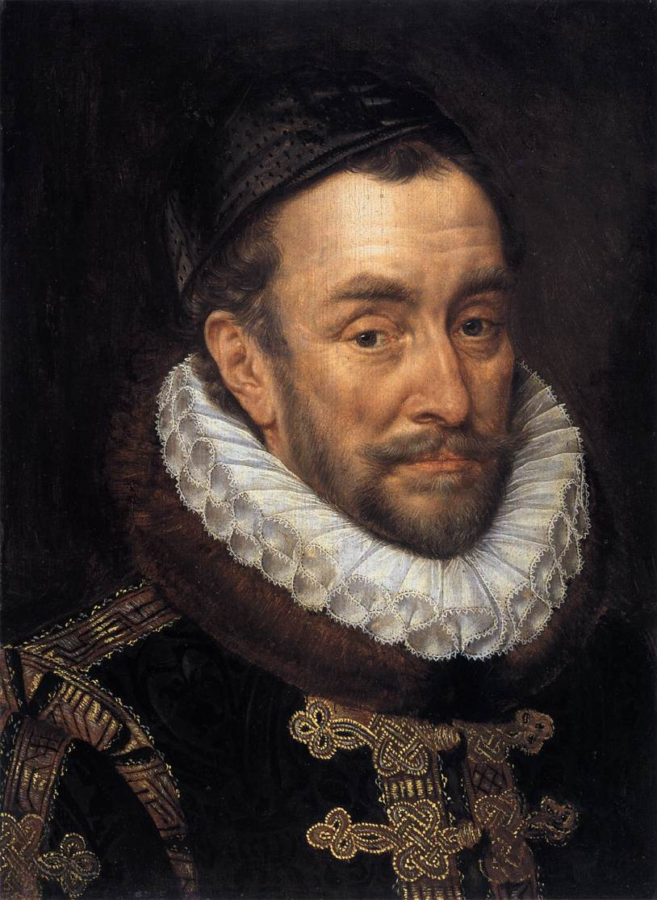
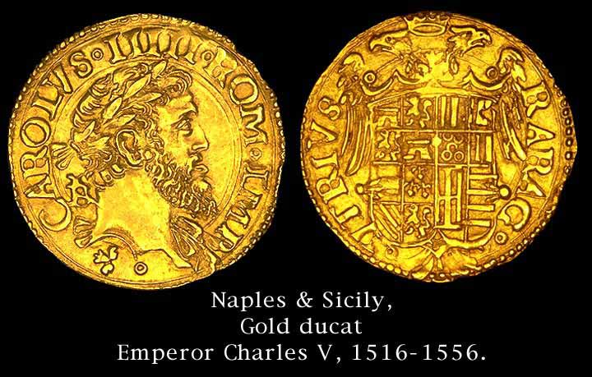
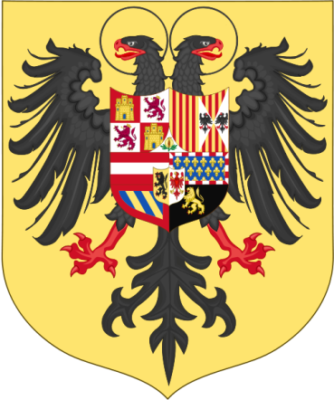
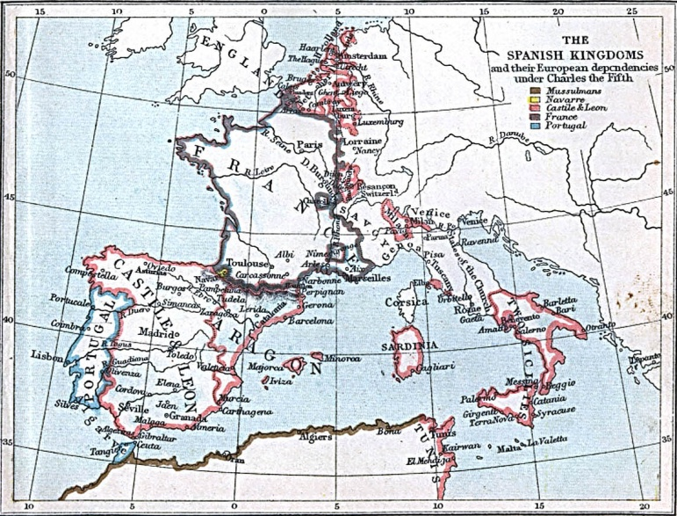
1516 – Charles I became King of Spain
Ruled Spanish colonies
Ruled Hapsburg Empire
Took name: Charles V.
Devout Catholic = Fought to suppress Protestantism
Faced Muslim Ottoman Empire
Abdicated in 1556
Empire too big to handle / divided it
Half to brother Ferdinand = Holy Roman Emperor
Gave Spain, a few other states &overseas Empire to son Phillip II

Slide 5
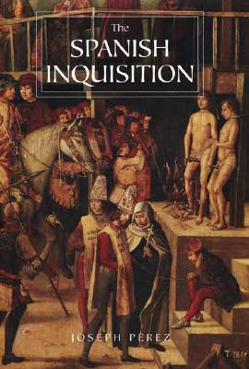
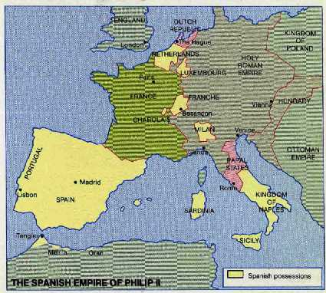
Phillip II of SPAIN & Divine Right
Made Spain even MORE powerful
Defeated Ottoman Fleet
Wanted to advance SPANISH CATHOLIC POWER -turned INQUISITION against Protestants - MUCH persecution
Reigned as ABSOLUTE MONARCH - believed he ruled by DIVINE RIGHT

Slide 6
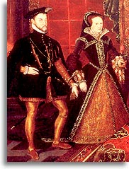
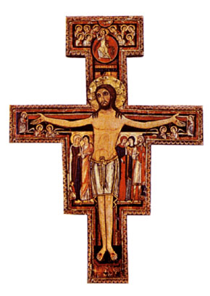
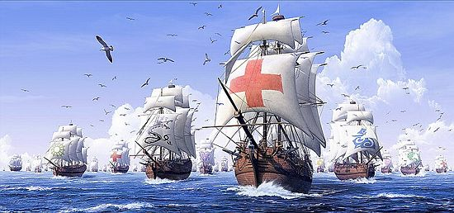
Phillip II of SPAIN
2nd marriage was to “Bloody Mary”, Queen of England - advocate of Catholic Power / persecuted Anglicans
Mary died – Elizabeth became queen, restored protestant rule
Saw England’s Queen Elizabeth (Protestant) as #1 Catholic enemy -attacked England in 1588

Slide 7
Phillip II of Spain wanted to invade England with the SPANISH ARMADA
130 ships, 20,000 men , in 1588
England sent fire ships
Terrible storms - many ships sunk
SPANISH ARMADA was defeated. This insured England’s future as a PROTESTANT NATION

Slide 8
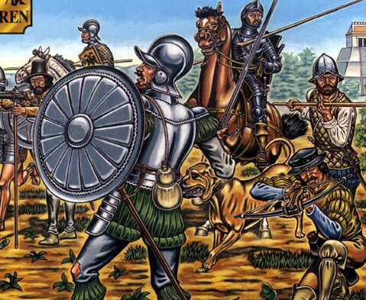
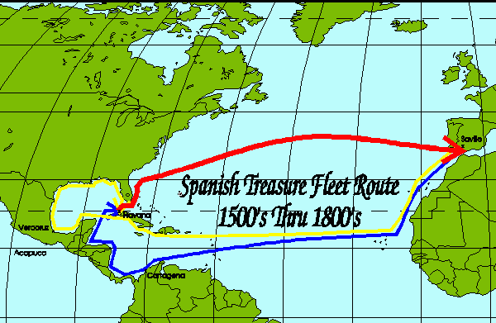
Defeat of Armada = beginning of the end of Spanish power
1600s – strength & prosperity declined
Costly wars
Expelling Muslims & Jews decreased money & skilled artisans
Treasure from Americas made them neglect farming & commerce

Slide 9
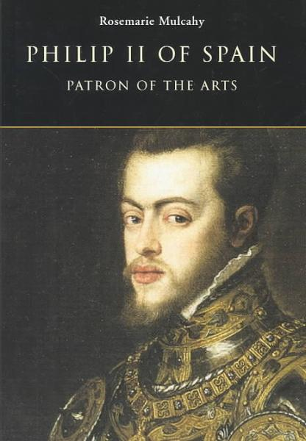
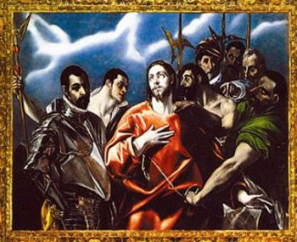
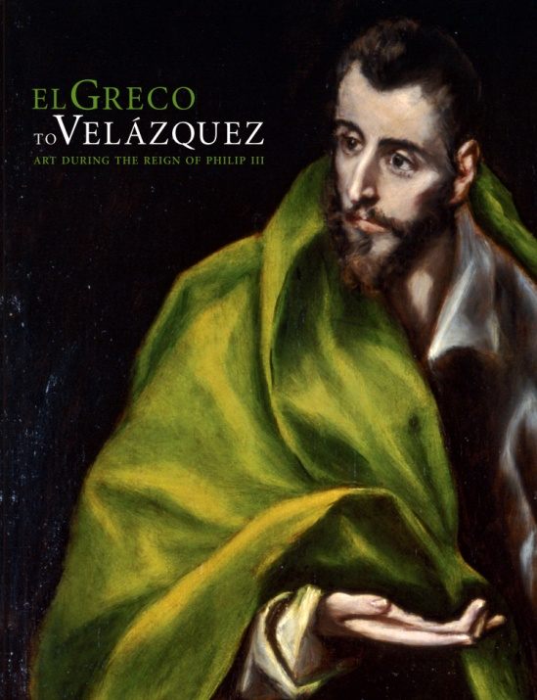
Spain’s Golden Age
1550 – 1650
Spain’s Siglo de Oro, “golden century”
Phillip II patron of the Arts
Founded academies of science & math
EL GRECO – famous painter
Studied in Italy
Haunting religious pictures
Royal Portraits
Vibrant colors

Slide 10
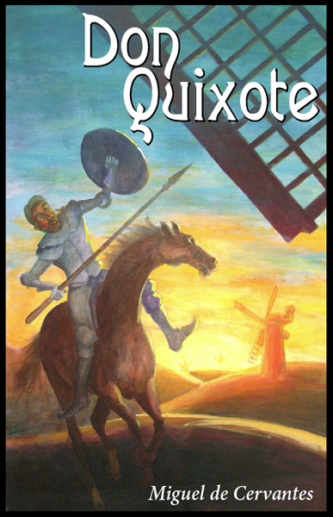
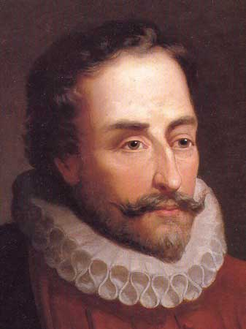
Spain’s Golden Age
1550 – 1650
MIGUEL DE CERVANTES –
most important writer of time
More than 1,500 plays
Witty comedies; action packed romance
Don Quixote – pokes fun at medieval tales of chivalry – considered Europe’s first modern novel

